Slide 1
The People, Practices and Products that Move AfL Forward
@Kristen Clarke
Instructional Coordinator, Assessment
Peel District School Board
#AssessPeel @Kristen__Clarke

Slide 3
Professional Learning Goals
By the end of this session, we will
So that we can use an equity mindset toward student learning and assessment.
understand strategies have been used to move AfL forward in Peel District School Board

Slide 4
Why Professional Learning Goals?
Model the use of classroom learning goals
Engage the learner in conversation around the knowledge and skill that is being targeted
Provide opportunity to collect evidence as to whether this is the correct goal for the learning opportunity

Slide 5
4 Ps
Purpose
People
Products
Processes

Slide 6
The Purpose of AfL

Slide 7
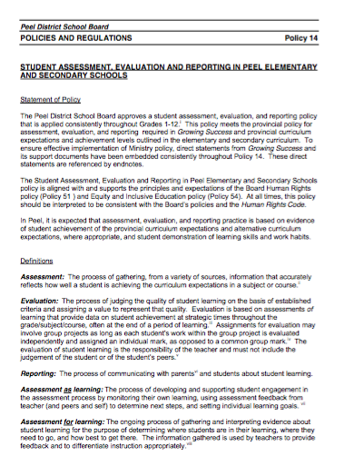
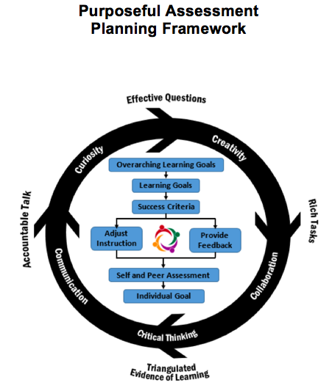
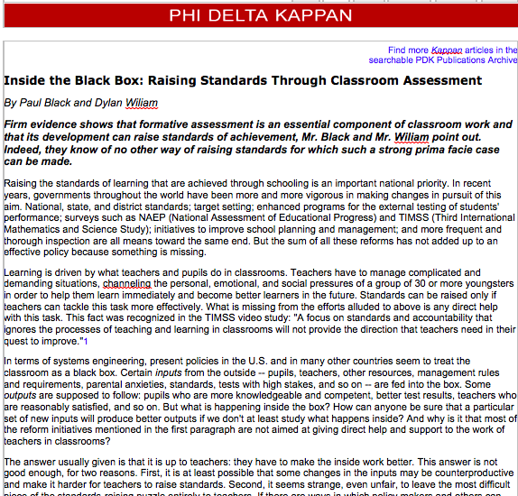
Connecting to the Purpose of AfL
Research
Ministry
Board
Notes:
1.25-

Slide 8
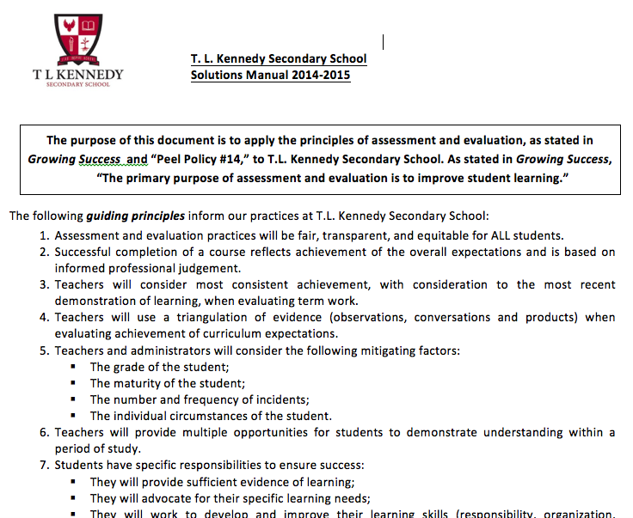
Connecting to the Purpose of AfL
School
Self
Notes:
1.25-

Slide 9
Strategy to Surface
the Purpose of AfL
Narratives
Share a positive assessment experience (Drake, Beckette & Reid, 2012)
Share how you shifted ‘that’ student
Share what you would want your child to experience
An assessment ‘aha’

Slide 10
Strategy to Surface
the Purpose of AfL
Responsive
Build professional learning to meet the needs of educators
Embedded
Connecting AfL into

Slide 11
Strategy to Surface
the Purpose of AfL
Embedded
Connecting AfL to other strategies and initiatives

Slide 12
Finding your People

Slide 13
People
Transparency & Empowerment
Students
Dept Head CI
Grade Level Teams
Those with influence
Teachers & Teacher Leaders
System and School Leaders
Parents
Key Admin Teams
Steering Committee
Goal not Grade?

Slide 14
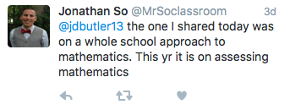
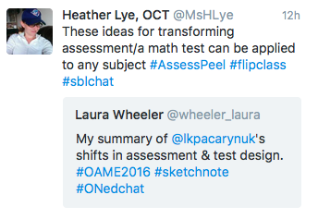
Strategy to Identify your People
Notice & Name People with Thoughtful Assessment Practices
Feed Their Interest!

Slide 15
Products

Slide 16
Evidence Based Strategies
Practical Resources supporting Instructional Rounds
Guides & Monographs
Edugains Videos
Student & Parent Voice
Products

Slide 17
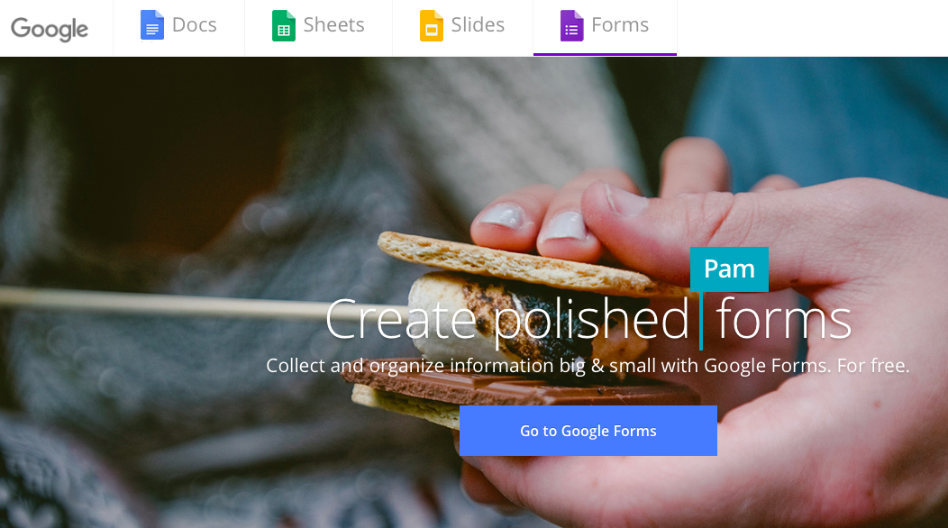
Strategy to Identify/Develop your AfL Products
Survey for resources in use and in demand

Slide 18
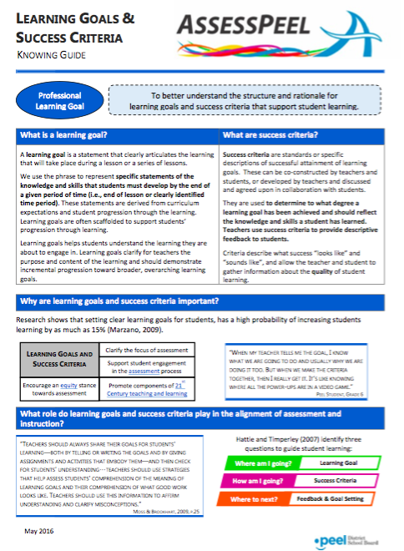
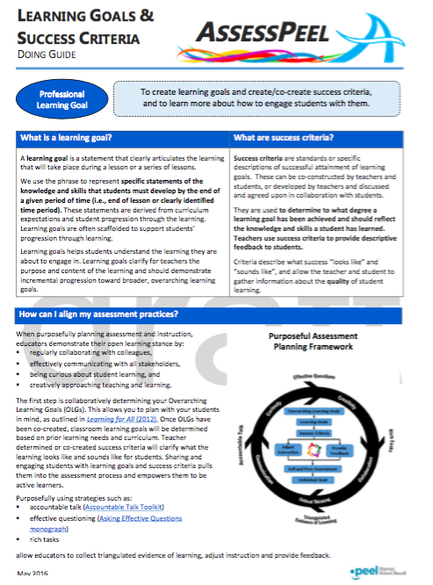

Slide 19
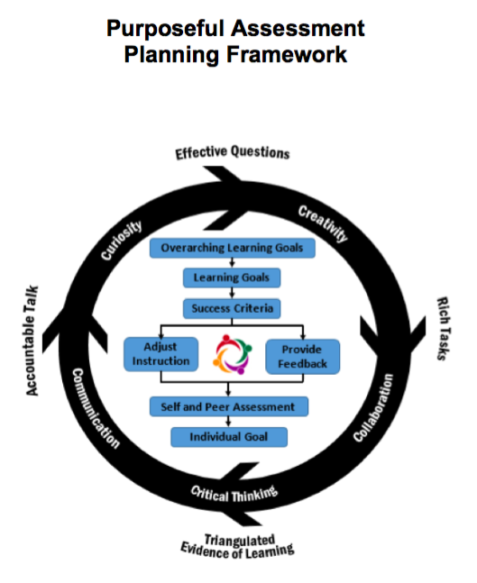

Slide 20
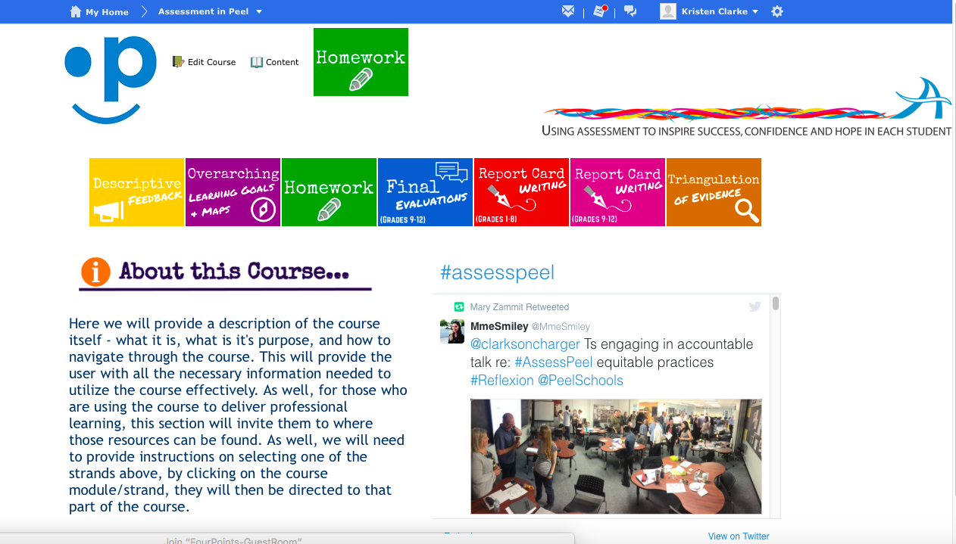

Slide 21
Processes

Slide 22
Collaborative Inquiry & Action Research
Processes
Virtual Learning
Sponsoring Canadian Research
SIM-SEF
NTIP & Mentorship

Slide 23
Strategy to Identify/Develop AfL Processes
Leverage what is there.
https://storify.com/kristen__clarke/peel-teacher-admin-assessment-work-teams

Slide 24
MEEGWETCH

Slide 25
What are your Ps?
People
Products
Processes

